Slide 1
Prototyping Operational Autonomy for Space Traffic Management
Sreeja Nag
David D. Murakami, Nimesh A. Marker,
Miles T. Lifson, Parimal H. Kopardekar
NASA Ames Research Center
California, U.S.A
October 21, 2019

Slide 2
Outline
Background on Space Traffic Management
How we’ve adapted the UTM concept to STM
STM Software Prototype
Application to Collision Screening and Manuevering
Discussion/Questions/Comments

Slide 3
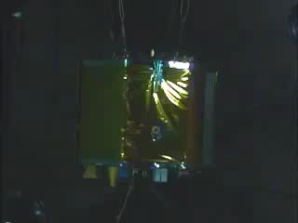
Space Traffic Management (STM)
“Space traffic management means the set of technical and regulatory provisions for promoting safe access into outer space, operations in outer space and return from outer space to Earth free from physical or radio- frequency interference.” – IAA Cosmic Study (2006)
“[P]lanning, coordination, and on-orbit synchronization of activities to enhance the safety, stability, and sustainability of operations in the space environment.” – Space Policy Directive 3
Why STM?
Today there are ~1,700 active satellites
~19,000 tracked objects (>10 cm) by US Joint Space Operations Center (JSpOC)
Future mega-constellations - 20,000+ proposed new satellites
Debris producing more debris: “Kessler Syndrome”
Collision with any tracked object (> 10 cm) looks like this (or worse):
NASA/DoD DebriSat Test Video (April 2014)
600 gram projectile impacting a 50 kg spacecraft model at 7 km/s, kinetic energy of 14.7 MJ (similar energy to anti-aircraft missile warhead). Produced over 200,000 fragments larger than 2 mm.

Slide 4


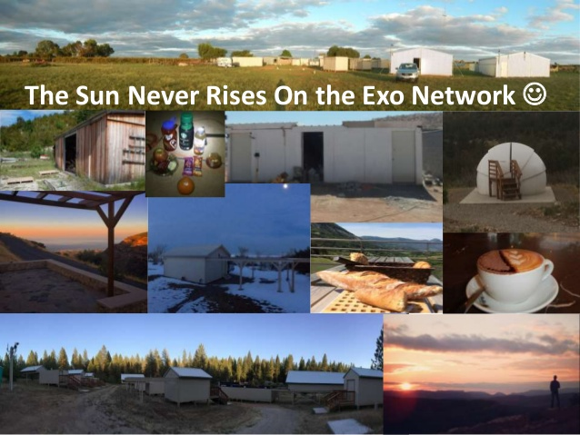



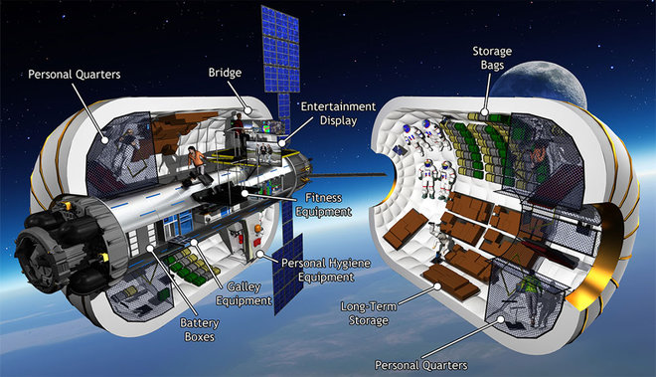


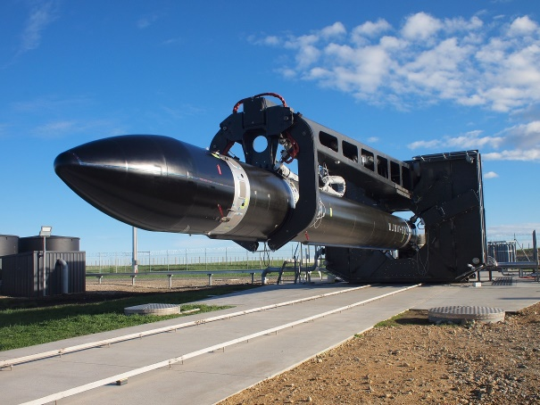

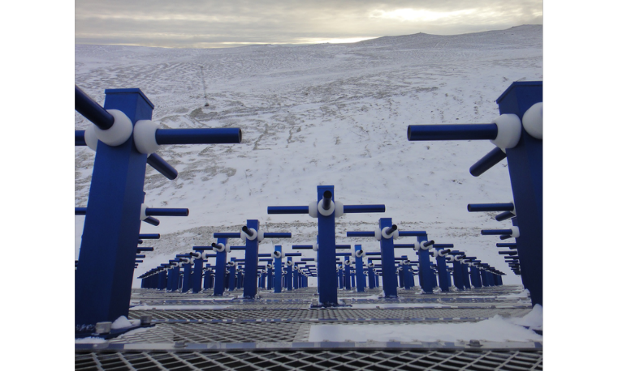

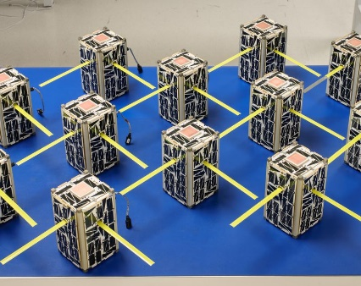

Rapid growth in LEO complexity
Megaconstellations (18,000 proposed satellites)
Cubesats (numerous, small, diverse)
New small launch vehicles
Increasing international, commercial participation
Increasingly contested military environment
Desire to separate JSpOC ‘weapon system’ from civil STM
New commercial Space Situational Awareness
New activities (asteroid mining, space tourism, commercial space habitats)
A new approach is necessary

Slide 5
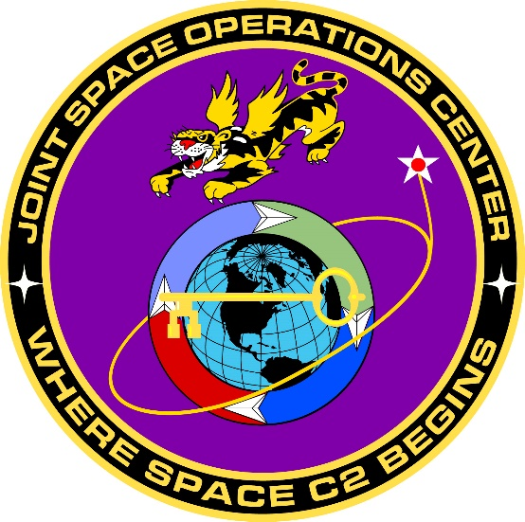




Current SSA State of Art => STM?
Government | Non-profit | Commercial
Basic SSA Information Anomaly Resolution Basic Emergency Conjunction Assessment Basic Emergency Collision Avoidance Advanced Services with SSA Sharing Agreement (All Free) | Conjunction Assessment, Maneuver Planning Validation Radio Frequency Interference Mitigation/Geolocation Database of Member Contact Information Legal and Technical Safeguards to Protect Proprietary Information Cooperative Member Ephemeris Information for Higher Accuracy | Commercial Non-Cooperative SSA Information Acquisition using Various Sensors and Sensor Types Orbit Determination Conjunction Warning & Assessment Anomaly Detection and Resolution

Slide 6
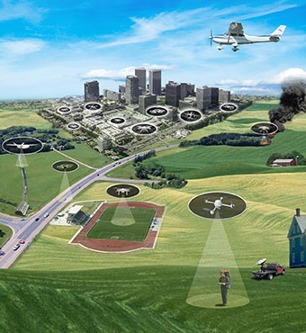
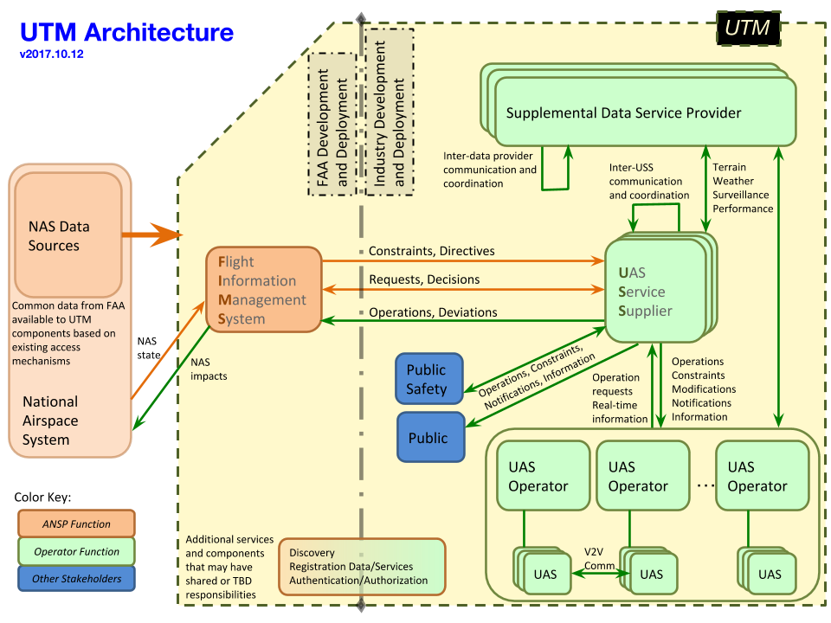
NASA Unmanned Aerial System Traffic Management (UTM) Summary
Collaborative effort to enable safe unmanned aircraft system operations in un-controlled low-altitude airspace.
Architecture and series of tests through joint research plan between FAA and NASA in partnership with industry.
Research Transition Teams to transfer prototype/lessons to FAA for operations

Slide 7
UAV Traffic Management => Space Traffic Management!
UTM Core Commonalities with STM:
New problems: Rapid growth in diverse assets, quantity of participants, complexity
New solution: Decentralized, highly automated, scalable architecture
UTM Differences against STM:
Difficult to know where everything is in space (SSA)
Space is not self-cleaning (debris)
Energy scales are vastly different
Impacts and interfaces are global
Existing players performing some services or using some functions
https://utm.arc.nasa.gov/index.shtml

Slide 8
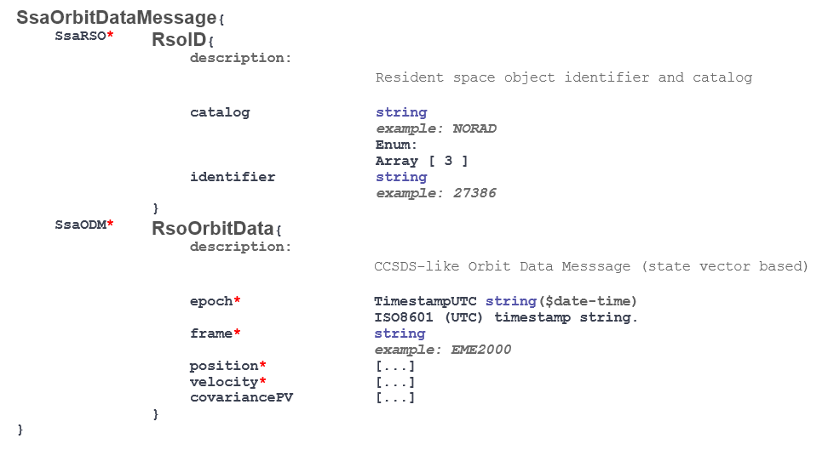
UAV Traffic Management => Space Traffic Management!
Open architecture to empower industry & facilitate commercialization
(1) Standardized roles, (2) machine-to-machine APIs, (3) data models
Decentralized, highly scalable, secure data sharing
Enables safe operations, cooperative management with diverse participants (large, small, commercial, gov’t)
Low barrier to entry for new participants (after reliable authentication) + be discoverable as a new participant by a centralized registry of participating entities
Management role defined, new roles can be added if needed

Slide 9
Roles and Responsibilities
Owner/Operator (O/O) - owns and flies the spacecraft of interest
STM Service Supplier (S3) - serves as the primary interface between O/Os and the greater STM community; procures STM services for the O/Os
Space Situational Awareness Supplier (SSA) – radar/telescope observations; maintains a catalog of RSOs (e.g. JSpOC, LeoLabs)
Conjunction Assessment Supplier (CAS) – responsible for screening RSO orbits to detect conjunctions; verifies that COLA maneuvers do not result in additional high risk conjunctions.
Supplemental Data Supplier (SDS) – additional data sources (e.g. space weather, atmosphere modeling)

Slide 10
Notional Core STM Architecture

Slide 11
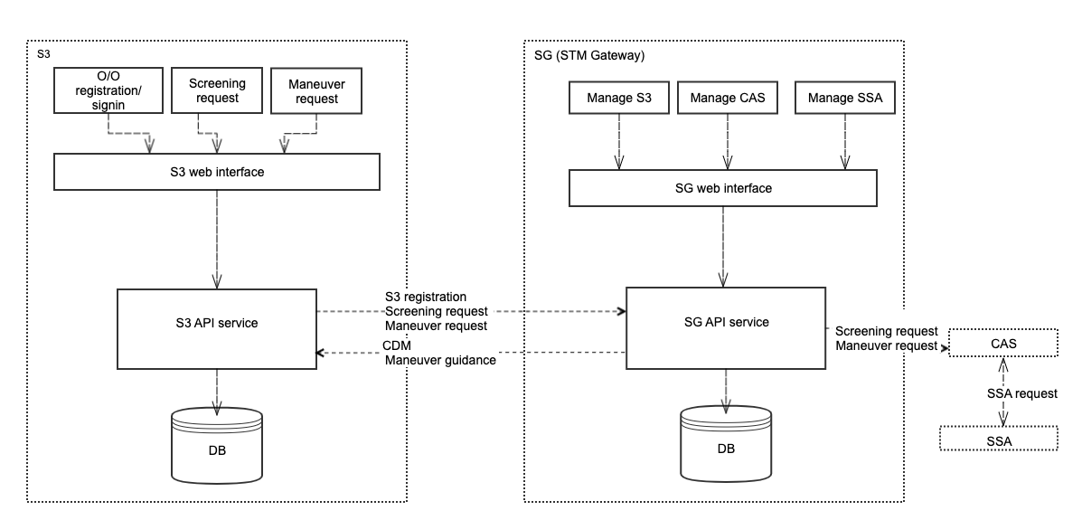
STM Prototype
Microservices allow the construction of small, independently versioned and scalable customer focused services with specific business goals which communicate with each other over standard protocols with well-defined interfaces
UI, API services, database, web server tradespace study + selection
Deployed into Docker Containers hosted on a VM
Prototype Functional Diagram:

Slide 12
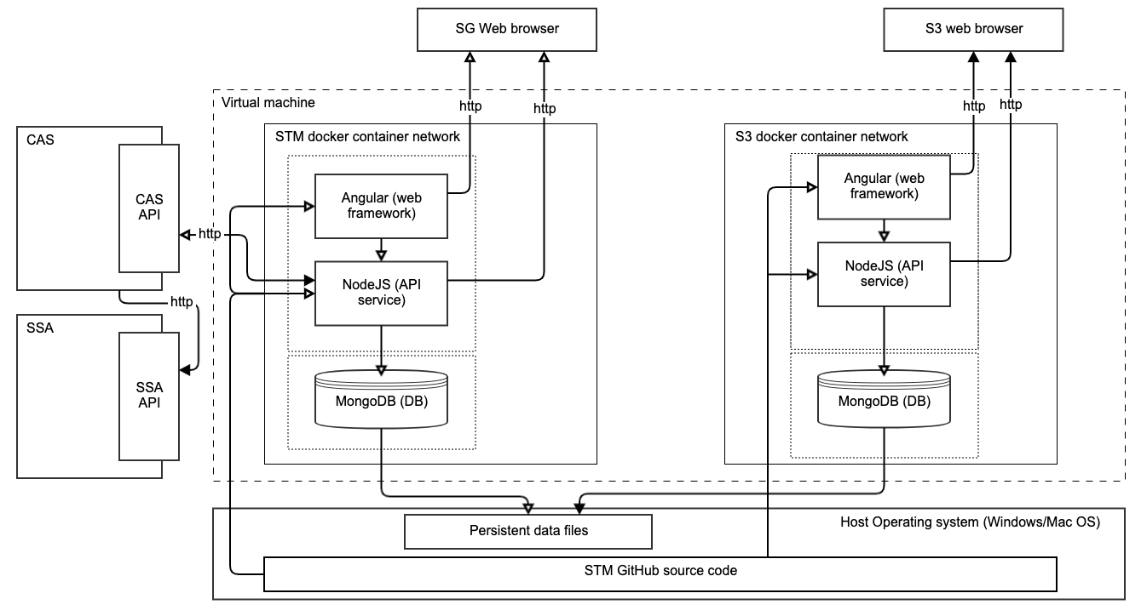
STM Prototype
Prototype Deployment Diagram:

Slide 13
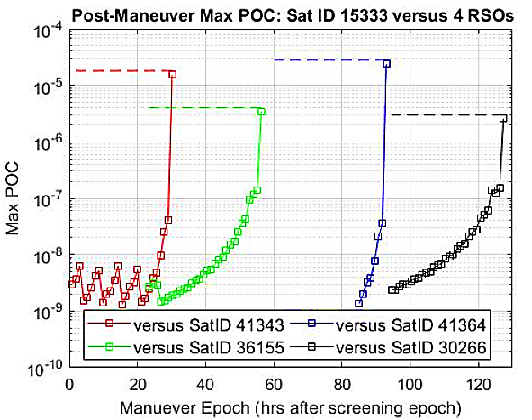
Conjunction Assessment & Collision Avoidance
Example CAS and Automated Manuever Advisor:
Conjunction Screening and Encounter Identification
STK’s HPOP propagator was used with TLE-derived state vectors for 6 primaries (1-vs-all)
MATLAB code that automated an instance of AGI STK and AdvCAT
Primary Conjunctions “do-not-violate” thresholds PoC = 1e-6, s/c ellipse 20 km × 10 km × 5 km
Maneuver Generation
For ΔV, maneuver location Δθ before the Time to Closest Approach (TCA), find optimal ΔV orientation to max miss distance
Generate Maneuever tradespace
Maneuver Planning
Minimize a reward function accounting for all conjunctions avoided and created, fuel or other manuever cost
Maneuver Screening
For secondary and tertiary conjunctions with all RSOs

Slide 14
Ames STM Research Environment
Objective: Develop and test prototype of STM ecosystem
Small-scale lab w/ workstations, server, hyperwall visualization
API (Swaggerhub) and user interface development for S3, CAS, SSA, STM Gateway microservices
NASA, AGI, MathWorks software suites
Concurrent use as STM decision making/autonomy research platform
CAS
SSA
S3
SG

Slide 15
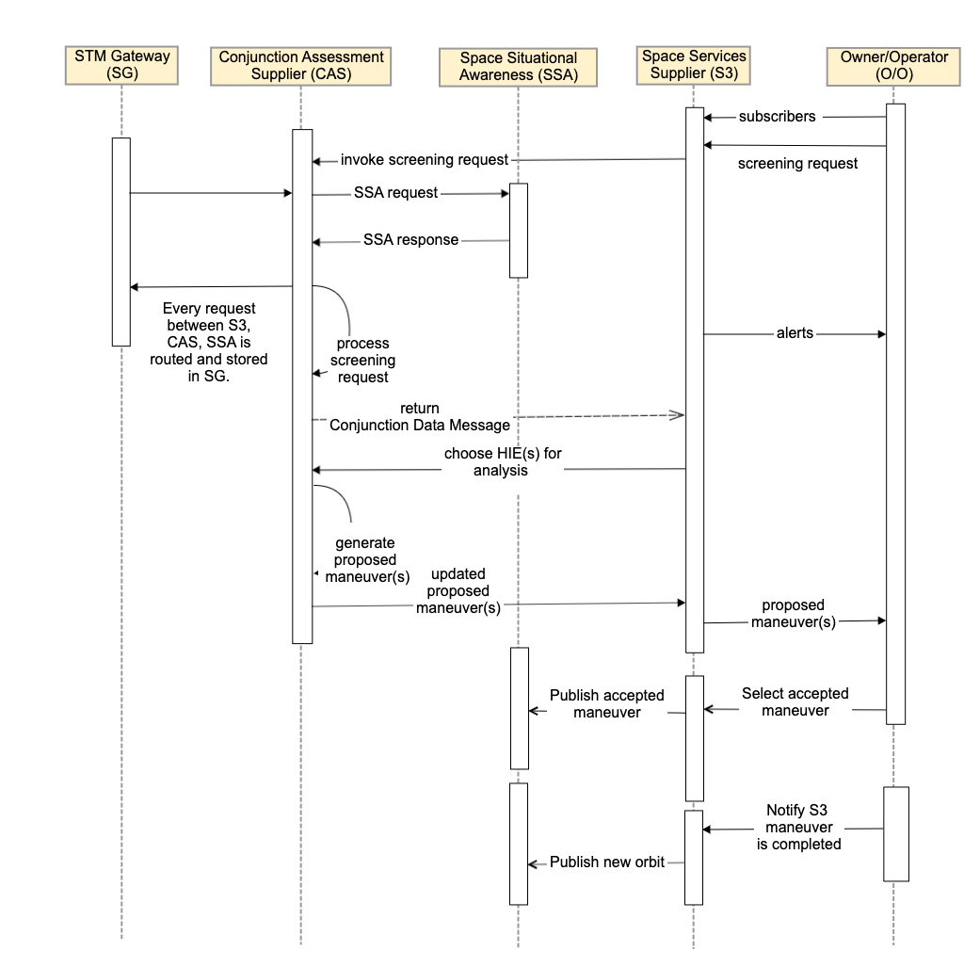
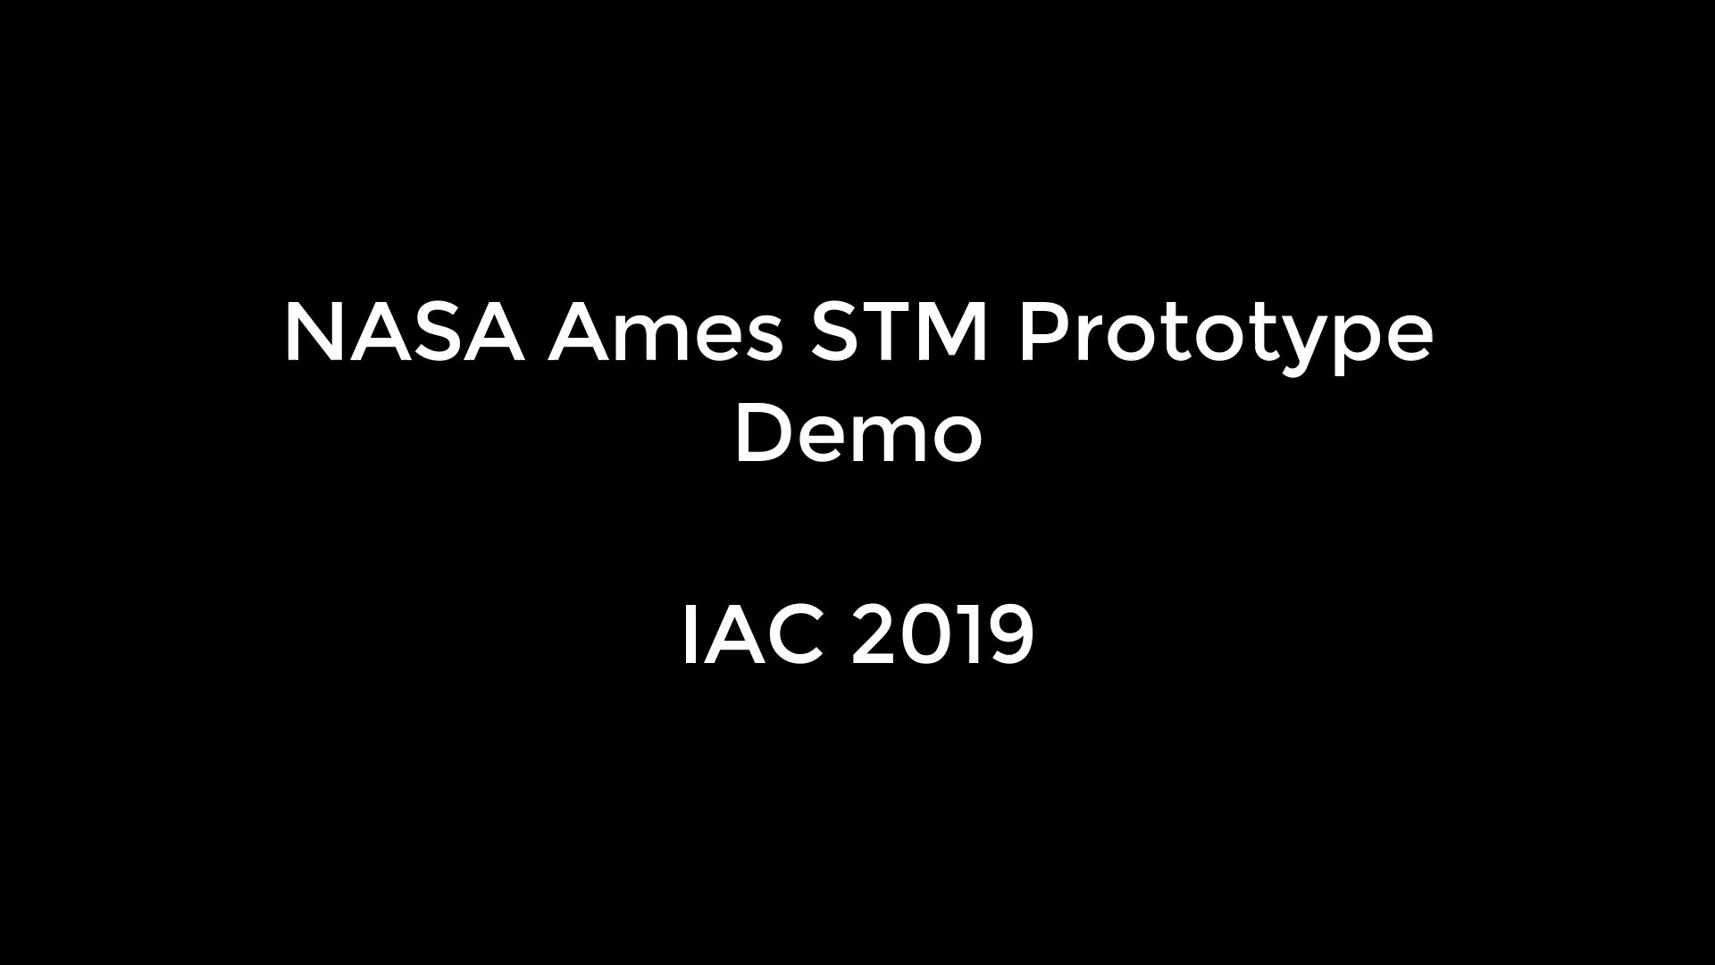
Demo

Slide 16
Multi-Spacecraft Maneuver Advisor
Single maneuverable satellite to avoid a conjunction with an uncooperative target
Single maneuverable satellite to avoid conjunction with a single maneuverable satellite, both controlled by the same S3
Multiple maneuverable satellites to avoid sequential conjunctions with multiple maneuverable satellites, all controlled by the same S3
Greedy algorithm to clear all HIEs involving at least one of S3’s 6 sats over sim period, by stepping through start to end, at every HIE
For HIE stop, the algorithm (1) screens for potential conjunctions, (2) generates a tradespace of COLA maneuvers for all S3 spacecraft, (3) calculates the reward for each candidate COLA maneuver, (4) selects and simulates the COLA maneuver with the highest reward, (5) repeats this process until the system is free of HIEs until the end of the simulation time period.
Multiple maneuverable satellites to avoid sequential conjunctions with multiple maneuverable satellites, controlled by different S3s
Maneuver negotiation needed, e.g. Coasian payments based, auction-based, resource-based, dual-manuever implicit cost split, or “space chicken”

Slide 17
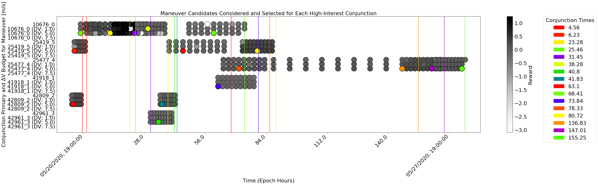
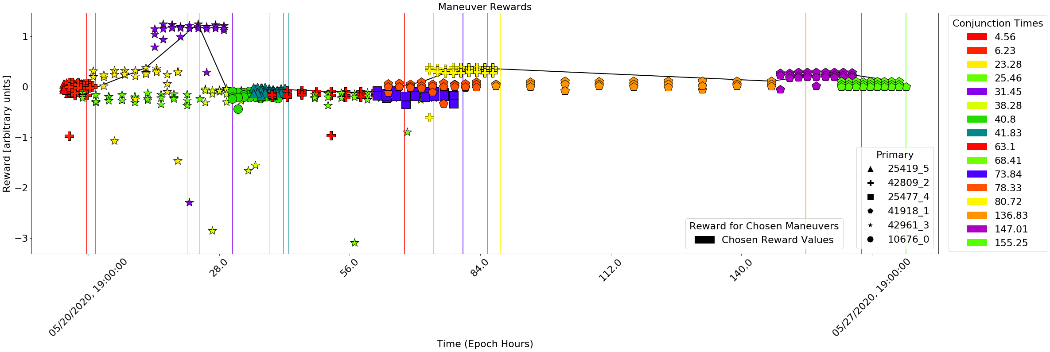
Collision Avoidance Maneuver Results

Slide 18
Summary
Proposed an STM architecture + software prototyped it with example service providers (e.g. CAS, AMA, SSA) and in-house toy models or publicly available algorithms for internal functions of the services. Will be natured over Tech Capability Levels like UTM
Presented a maneuver planner and reward function as a strawman for future STM services.
The STM architecture and standardization of interaction between entities paves the way for a research ecosystem similar to other AI/autonomy fields
Development cycle of the STM prototype per Technical Capability Level:

Slide 19
Questions or Feedback?
Sreeja.Nag@nasa.gov
David.d.Murakami@nasa.gov

Slide 20





Current U.S. Space Regulatory Environment
Launch &
Re-entry
Non-Federal Spectrum Use
(including debris mitigation as condition of spectrum use)
Commercial Remote Sensing
International Traffic in Arms Regulations (ITAR)
Export Control
Export
Administration Regulations (EAR)
Export Control
There is no U.S. government body with regulatory authority to conduct on-orbit space traffic management.
Notes:
Space Policy Directive 2 directed review of a lot of space-related regulatory authority with an aim of streamlining regulation.
Space Policy Directive 3 is a policy document with intention of moving civil SSA to Commerce, using catalog data from JSPOC, along with data from other sources.
DoD is not listed since doesn’t directly regulate launches, but participates in the interagency as relevant.
Outer Space Treaty makes launching states responsible for their government and commercial space activities.
Satellite-level (as opposed to maneuver level) authorization, no SWIM, NAS, or governmental traffic control.
Significant freedom of movement for operators, emphasis on enabling coordination rather than control
Ad-hoc structures have developed to provide STM/SSA services

Slide 21
Potential Collaborations
Government Operators and S3 - NASA GSFC’s Conjunction Assessment Risk Analysis team
Industry Operators – Planet Labs
Academic Operators – CalPoly CubeSat Lab
Industry Service Providers/S3 - AGI ComSpoc
Academic SSA – UT Austin, MIT
Industry SSA – LeoLabs
Industry SSA and S3 – Space Data Association
Academia Manuever Deconfliction – Stanford

Slide 22
Strawman Technical Capability Levels (TCLs)
Capability 1: Demonstrated STM for Small Sats
On-orbit operations
Open interface and data validation
Civil (commerce) /commercial catalog(s)
Small satellites S3 conjunction assessment & warning, COLA planning
Product: Overall con ops, architecture, and roles, use case
Capability 2: Full Physical STM and RFI
Autonomous maneuver planning/deconfliction (small and large satellites)
Interaction with crewed spacecraft
Radio-frequency Interference
Coordination with non-participants/classified entities
Product: Requirements, interfaces, and proof of concept for broader set of participants/services
Capability 3: Mature Concept, Expanded Capabilities
Space weather
Single actionable catalog + data fusion
Support for mega-constellations
Procedures and “rules-of-the-road”
Product: mature concept incorporating regulator policy choices
Capability 4: Internationalization and Integration with Air Traffic Management
Launch and reentry, sub-orbital
Internationalization of system?
Active debris removal/rendezvous and proximity operations
Laser/directed energy integration
Product: comprehensive architecture for STM covering all phases of activity, coordination with other countries
Evolutionary approach: build capability by function and user needs

Slide 23
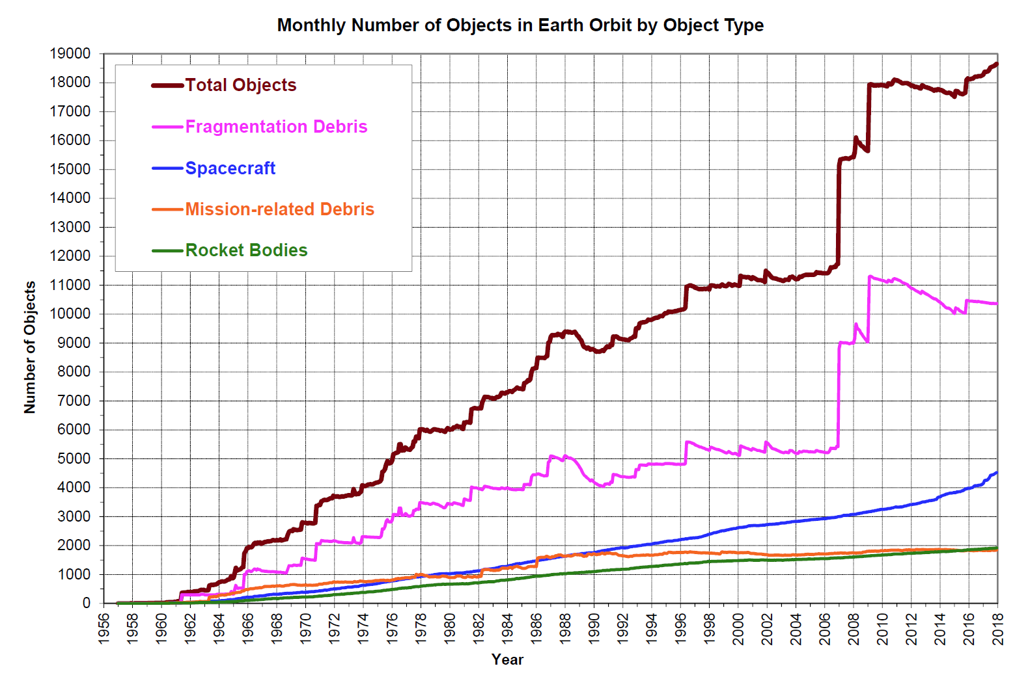
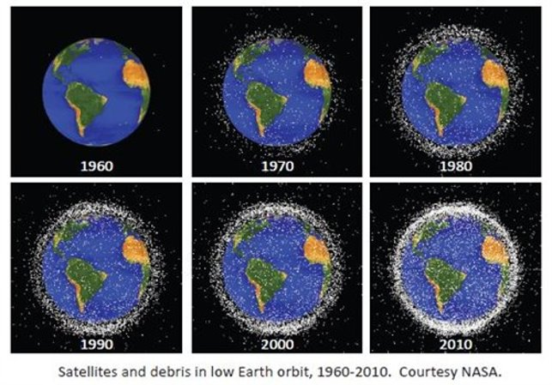
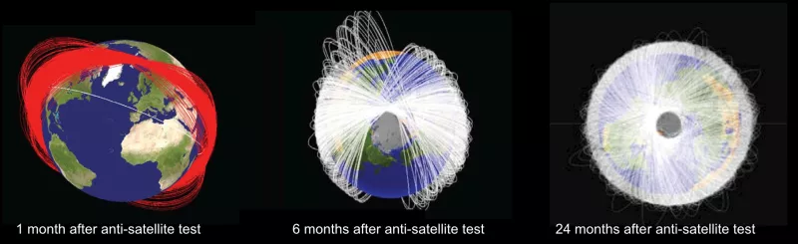
Visualizing The Problem
Iridium/Cosmos
Chinese ASAT Test
Notes:
You might think that when you put something into an orbit, it stays there. Not true, it's a dynamic environment.
Things in an orbit don't stay in that orbit, due to perturbations. State vectors have to be continuously updated with new observations, and errors grow with time squared.
The main effect is all the false alarms. You have to maneuver to get out of the way, imposing costs.

